Slide 1
Edge Security Bootcamp
OAuth - Implicit

Slide 2
OAuth grants
An OAuth Grant is a credential representing the resource owner’s authorization. More often than not, we tend to think of grants in terms of the process used to obtain an access token.
Grant Type | Typical Use Case | Complex?
No specific resource owner is involved
Client Credentials | Business system interactions, where resources being operated on are owned by the partner, not a particular user | No
A specific resource owner is involved
Resource Owner Password Credentials | Resources are owned by a particular user and the requesting application is trusted | A bit
Authorization Code | Resources are owned by a particular user and the requesting application is untrusted | Very
Implicit | Resources are owned by a particular user, and the requesting application is an untrusted browser-based app written in a scripting language such as JavaScript | Very, and potentially insecure as well

Slide 3
Implicit grant type
A simplified version of authorization code
Resources participating in authorization code grant type
End user
Client application
User agent
Edge - generating and validating token
Authentication server - to validate the credentials
Backend API resource
Used when the app resides on the client
For example, the app's code is implemented in a browser using JavaScript
Authorization server returns an access token directly when the user is authenticated, rather than issuing an authorization code first
Can improve app responsiveness in some cases
This advantage needs to be weighed against possible security implications as described in the IETF specification

Slide 4
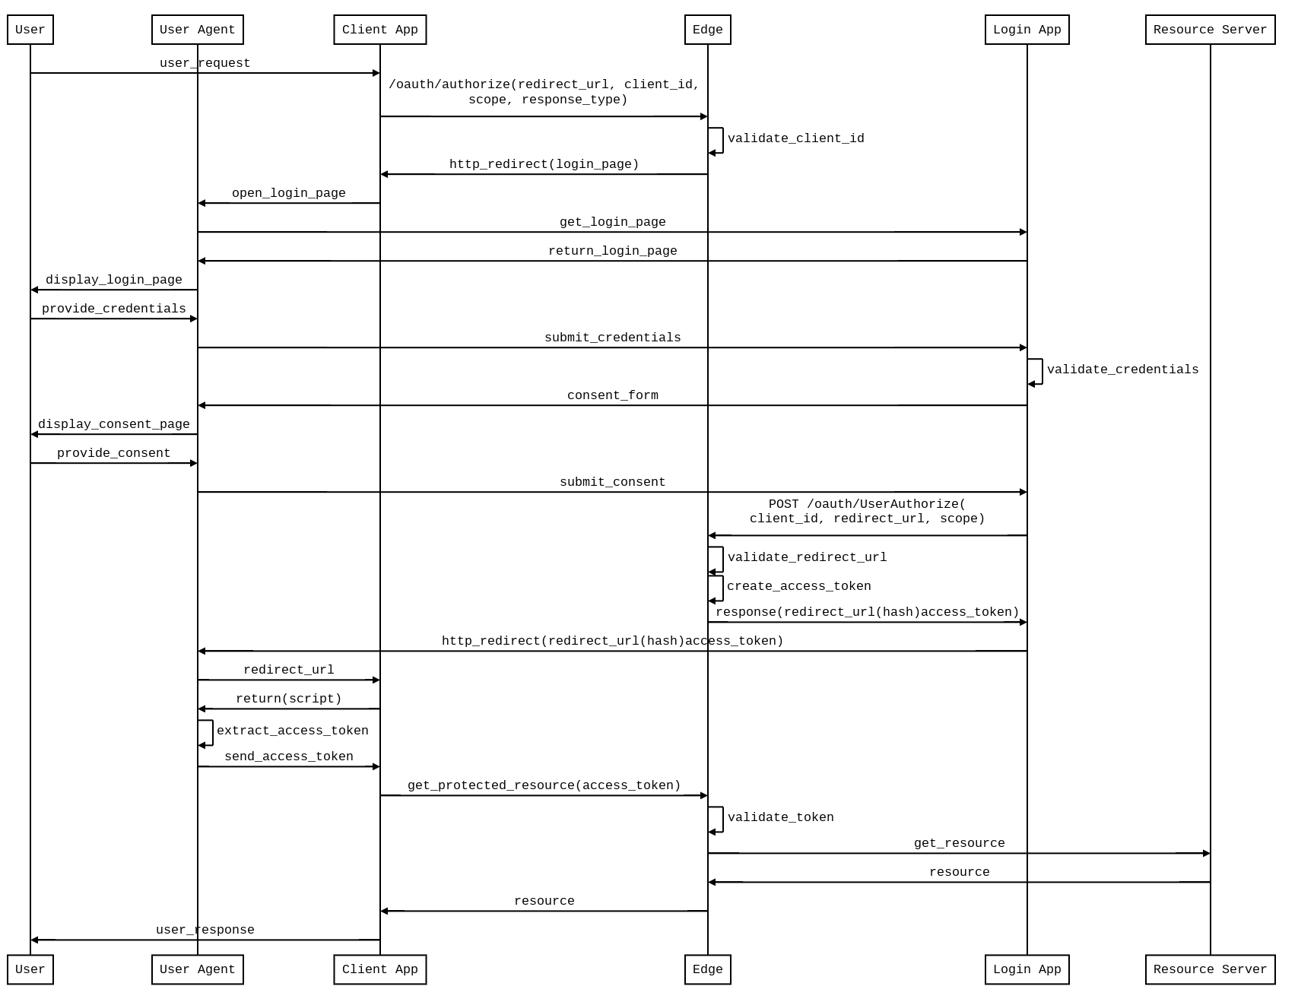
Implicit - Sequence diagram

Slide 5
Generate implicit access token
<OAuthV2 async="false" continueOnError="false" enabled="true" name="GenerateAccessTokenImplicit">
<DisplayName>GenerateAccessTokenImplicit</DisplayName>
<Operation>GenerateAccessTokenImplicit</Operation>
<ExpiresIn>600000</ExpiresIn>
<GenerateResponse/>
</OAuthV2>

Slide 6
Verify OAuth token policy
The OAuthV2 policy’s “VerifyAccessToken” operation will validate the access token for subsequent requests for all grant types.
Set the access token as the Bearer token in the Authorization header of the http request.
<?xml version="1.0" encoding="UTF-8" standalone="yes"?>
<OAuthV2 async="false" continueOnError="false" enabled="true" name="VerifyOAuthToken">
<DisplayName>OAuth Verify Token</DisplayName>
<Operation>VerifyAccessToken</Operation>
</OAuthV2>
curl -H "Authorization: Bearer {access_token}" http://myorg-test.apigee.net/v1/cc/oauth_cc_weather/forecastrss?w=12797282

Slide 7
THANK YOU

